Slide 1
Hands on Machine Learning with Scikit Learn
Presented By:
Ahmed Yousry

Slide 2
Agenda
Introduction to Artificial Neural Networks.
Training Deep Neural Nets.
Convolutional Neural Networks.

Slide 3
Introduction to ANN
First introduced back in 1943 by the Warren McCulloch .
Successes of ANNs until the 1960s.
In the early 1980s there was a revival of interest in ANNs as new network architectures.
By the 1990s, powerful alternative Machine Learning techniques.

Slide 4
Reasons why ANN is much more profound impact
There is now a huge quantity of data.
The tremendous increase in computing power.
The training algorithms have been improved.
Theoretical limitations of ANNs have turned out to be benign.
virtuous circle of funding and progress and products.

Slide 5
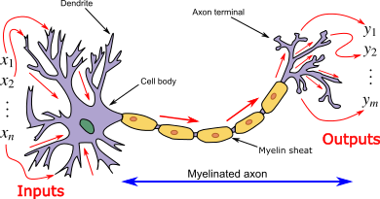
Biological Neurons

Slide 6
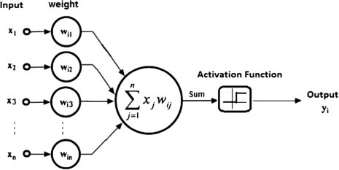
ANN simulation

Slide 7
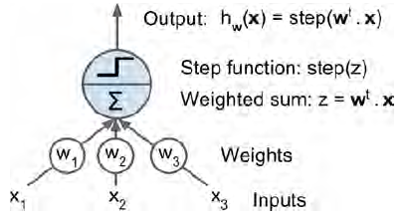
The Perceptron
One of the simplest ANN architectures, invented in 1957 by Frank Rosenblatt.
It is based on a linear threshold unit (LTU).
Z = w1 x1 + w2 x2 + ⋯
+ wn xn = wT ・ x
hw(x) = step (Z)
= step (wT ・x)

Slide 8
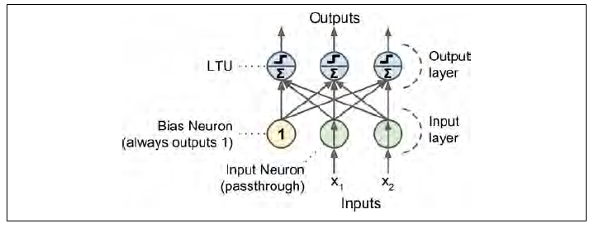
Multioutput perceptron
A Perceptron with two inputs and three outputs.
Note : No hidden layers in perceptron.

Slide 9
Training Algorithm
While epoch produces an error
Present network with next inputs from epoch
Err = T – O
If Err <> 0 then
W_{j new} = W_{j old} + LR * I_{j} * Err
End If
End While
T: actual output , O: predicted output
LR : learning rate , I :input

Slide 10
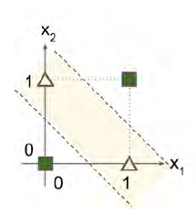
XOR classification problem and an MLP that solves it
2
2
X₁
-1
Z₁
Y
-1
Z₂
X₂
2
2
XOR Function
X₁ XOR X₂ = (X₁ AND NOT X₂) OR (X₂ AND NOT X₁)

Slide 11
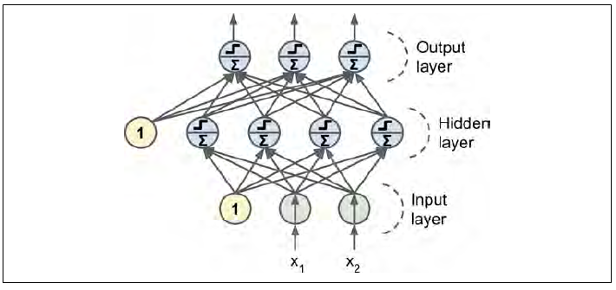
Multi-Layer Perceptron and Backpropagation
An MLP is composed of one input layer, one or more layers of LTUs, called hidden layers, and one final output layer
When an ANN has two
or more hidden layers, it is called
a deep neural network (DNN).

Slide 12
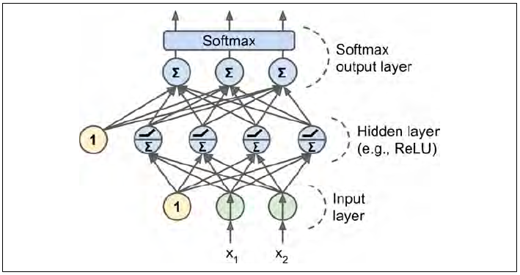
A modern MLP (including ReLU and softmax) for classification

Slide 13
Deep learning Problems
Vanishing gradients problem (or the related exploding gradients problem) lower layers very hard to train.
Second, with such a large network, training would be extremely slow.
Third, a model with millions of parameters would severely risk overfitting the training set.

Slide 14
Gradients problems
Gradients often get smaller as the algorithm progresses down to the lower layers.
The Gradient Descent update leaves the lower layer weights unchanged, and training never converges to a good solution.
This is called the vanishing gradients problem.
The gradients can grow bigger and bigger, so many layers get insanely large weight updates and the algorithm diverges. This is the exploding gradients problem

Slide 15
Solving the first problem(Van…)
A paper titled “Understanding the Difficulty of Training Deep Feedforward Neural Networks” by Xavier Glorot and Yoshua.
popular logistic sigmoid activation function.
using a normal distribution with a mean of 0 and a standard deviation of 1.
the hyperbolic tangent function has a mean of 0 and behaves slightly better than the logistic function in DNN.

Slide 16
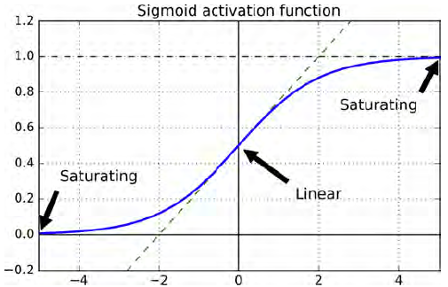
Sigmoid activation function
you can see that when
inputs become large (negative or positive), the function saturates at 0 or 1, with a
derivative extremely close to 0.
1/1+e^-x

Slide 17
The problem of RELU (0,max)
It suffers from a problem (dying ReLUs) during training, some neurons effectively die.
they stop outputting anything other than 0.
In some cases, you may find that half of your network’s neurons are dead training.
To solve this problem, you may want to use a variant of the ReLU function, such as the leaky ReLU.

Slide 18
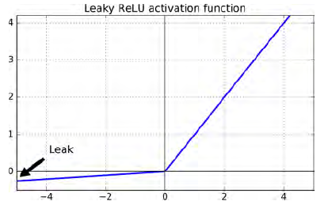
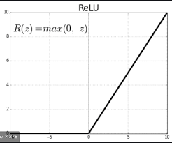
leaky ReLU (RReLU).
leaky variants always outperformed the strict ReLU activation function. In fact, setting α = 0.2 (huge leak) seemed to result in better performance than α = 0.01 (small leak).
They also evaluated the randomized leaky ReLU (RReLU).
also evaluated the parametric leaky ReLU (PReLU),

Slide 19
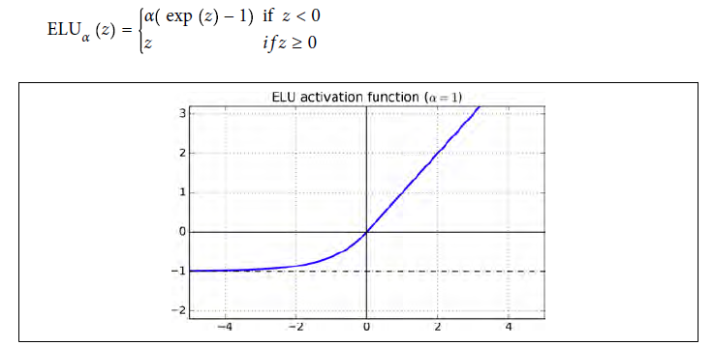
Exponential linear unit (ELU)
Outperformed all the ReLU variants in their experiments: training time was reduced and the neural network performed better on the test set.

Slide 20
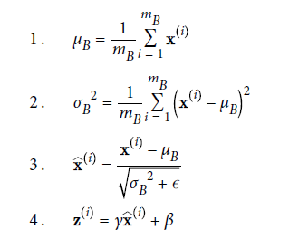
Batch Normalization
The technique consists of adding an operation in the model just before the activation function of each layer.
Simply zero-centering and normalizing the inputs, then scaling and shifting the result using two new parameters per layer (one for scaling, the other for shifting).
In other words, this operation lets the model learn the optimal scale and mean of the inputs for each layer.
γ is the scaling parameter for the layer.
β is the shifting parameter (offset) for the layer.

Slide 21
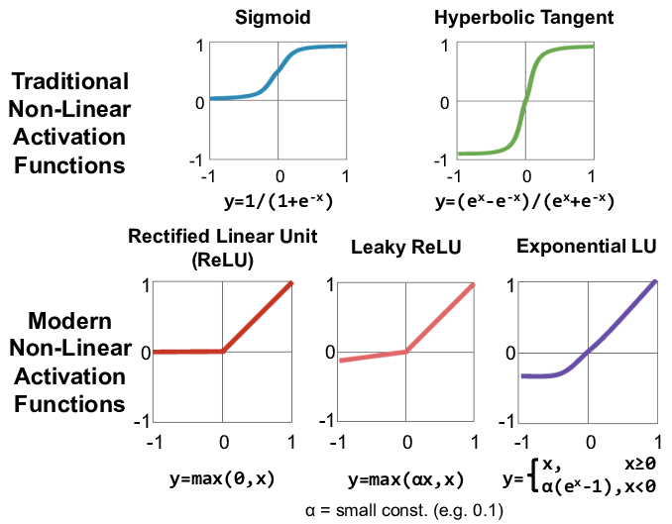
Activation functions

Slide 22
Reusing Pretrained Layers
It is generally not a good idea to train a very large DNN from scratch.
Try to find an existing neural network that accomplishes a similar task.
Reuse the lower layers of this network.
This is called transfer learning.

Slide 23
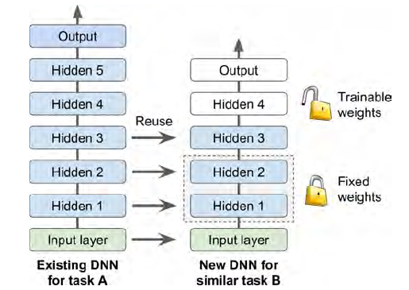
Example
DNN that was trained to classify pictures into 100 different categories.
You now want to train a DNN to classify specific types of vehicles.
Freezing the Lower Layers weights.
Tweaking, Dropping, or Replacing the Upper Layers.

Slide 24
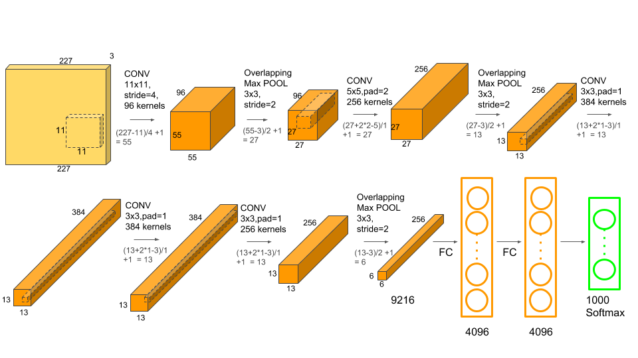
Understanding AlexNet
Consists of 5 Convolutional Layers and 3 Fully Connected Layers (classify 1000 classes)

Slide 25
Faster Optimizers
Five ways to speed up training (and reach a better solution):
Applying a good initialization strategy for the connection weights.
using a good activation function.
Using Batch Normalization.
Reusing parts of a pretrained network.
Using a faster optimizer than the regular Gradient Descent optimizer.
the most popular ones: Momentum optimization, Nesterov Accelerated Gradient, AdaGrad, RMSProp, and finally Adam optimization.

Slide 26
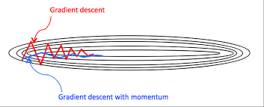


Momentum Optimization Algorithm
Gradient Descent simply updates the weights θ by directly subtracting the gradient of the cost function J(θ) with regards to the weights (∇θJ(θ)) multiplied by the learning rate η (equation 1)
Momentum optimization cares a great deal about what previous gradients were.
It updates the weights by simply subtracting this momentum vector.
A new hyperparameter β, simply called the momentum, which must be set between 0 and 1, typically 0.9. (equation 2)
Gradient Descent (1)
Momentum Optimization (2)

Slide 27
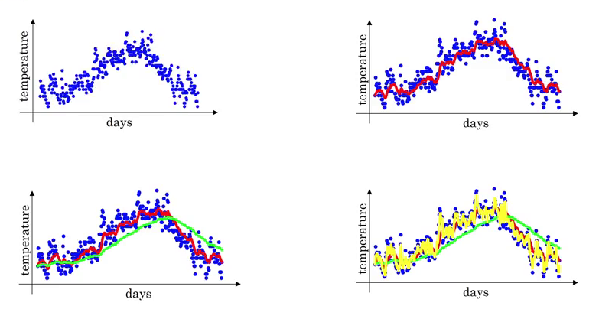

Slide 28
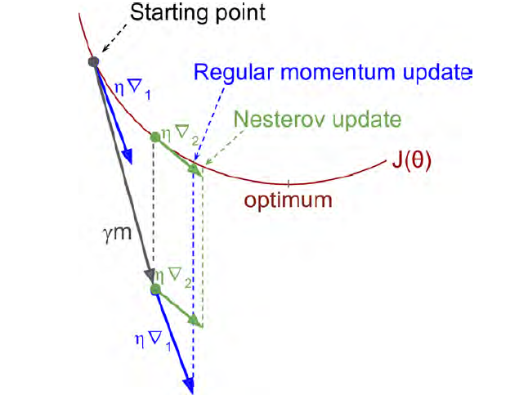

Nesterov Momentum optimization
The only difference from vanilla Momentum optimization is that the gradient is measured at θ + βm rather than at θ.
This small tweak works because in general the momentum vector will be pointing in the right direction
where ∇1 represents the gradient of the cost function measured at the starting point θ, and ∇2 represents the gradient at the point located at θ + βm)

Slide 29

RMS Optimization
Accumulating only the gradients from the most recent iterations (as opposed to all the gradients since the beginning of training).
It does so by using exponential decay in the first step.
generally performs better than Momentum optimization and Nesterov Accelerated Gradients.
In fact, it was the preferred optimization algorithm of many researchers until Adam optimization came around.

Slide 30
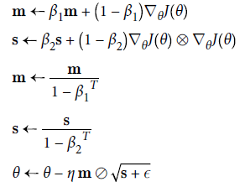
Adam Optimization
Stands for adaptive moment estimation.
Combines the ideas of Momentum optimization and RMSProp.
Steps 3 and 4 are somewhat of a technical detail: since m and s are initialized at 0, they will be biased toward 0 at the beginning of training, so these two steps will help boost m and s at the beginning of training.
Initialize β1 = 0.9, β2 =0.999, η = 0.001
term ϵ initialized to a tiny number 10–8 to avoid division by 0.

Slide 31
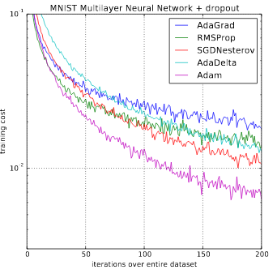
Difference between optimizers

Slide 32
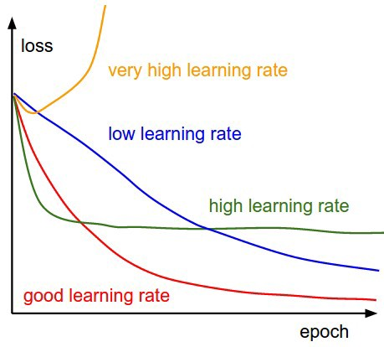
Learning rate curves

Slide 33

Learning rate techniques
Predetermined piecewise
constant learning rate For example, set the learning rate to η0 = 0.1 at first, then to η1 = 0.001 after 50 epochs.
Performance scheduling
Measure the validation error every N steps (just like for early stopping) and reduce the learning rate by a factor of λ when the error stops dropping.
Exponential scheduling
Set the learning rate to a function of the iteration number t:
This works great, but it requires tuning η0 and r. The learning rate will drop by a factor of 10 every r steps.
Power scheduling
Set the learning rate to η(t) = η0 (1 + t/r)–c The hyperparameter c is set to 1. This is similar to exponential scheduling, but the learning rate drops much more slowly.

Slide 34
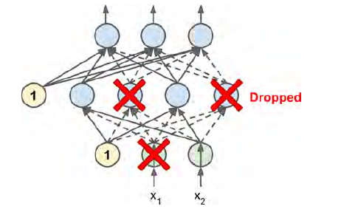
Dropout
It is a fairly simple algorithm: at every training step, every neuron (including the input neurons but excluding the output neurons) has a probability p of being temporarily “dropped out,” meaning it will be entirely ignored during this training step, but it may be active during the next step

Slide 35
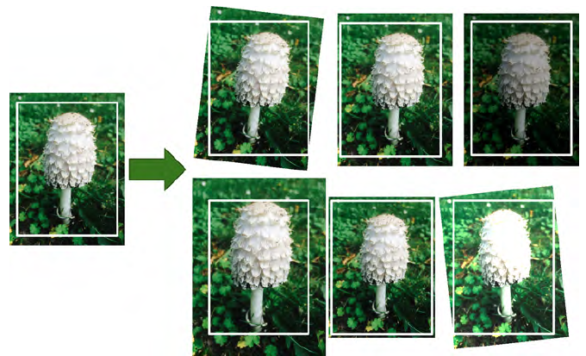
Data Augmentation
Consists of generating new training (rotating, resizing, flipping, and cropping) instances from existing ones, artificially boosting the size of the training set.
This will reduce overfitting, making this a regularization technique. The trick is to generate realistic training instances.

Slide 36
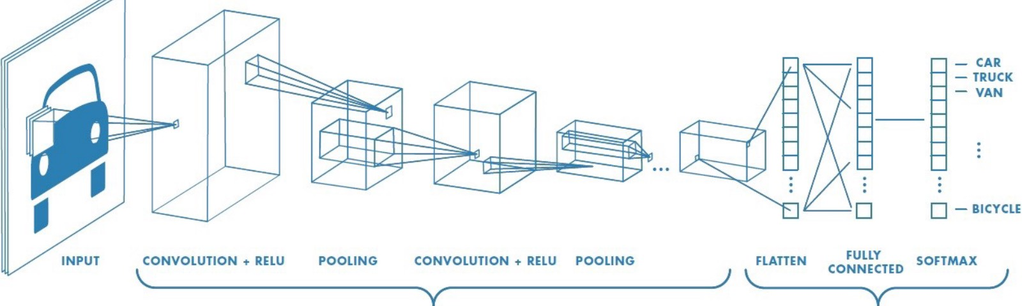
Convolutional Neural Networks
A convolutional neural network (or ConvNet) is a type of feed-forward artificial neural network.
The architecture of a ConvNet is designed to take advantage of the 2D structure of an input image.
A ConvNet is comprised of one or more convolutional layers (often with a pooling step) and then followed by one or more fully connected layers as in a standard multilayer neural network.

Slide 37
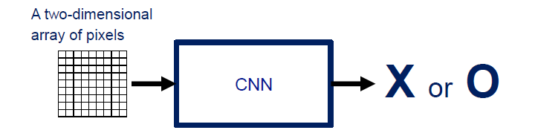
How CNN works
For example, a ConvNet takes the input as an image which can be classified as ‘X’ or ‘O’

Slide 38
ConvNet Layers
▪CONV layer will compute the output of neurons that are connected to local regions in the input, each computing a dot product between their weights and a small region they are connected to in the input volume.
▪RELU layer will apply an elementwise activation function, such as the max(0,x) thresholding at zero. This leaves the size of the volume unchanged.
▪POOL layer will perform a down sampling operation along the spatial dimensions (width, height).
▪FC (i.e. fully-connected) layer will compute the class scores, resulting in volume of size [1x1xN], where each of the N numbers correspond to a class score, such as among the N categories.

Slide 39
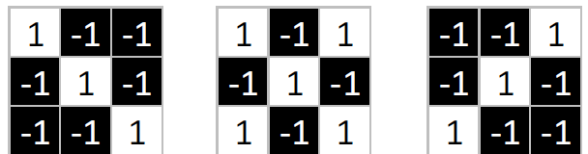
Convolutional Layer - Filters
The CONV layer’s parameters consist of a set of learnable filters.
Every filter is small spatially (along width and height), but extends through the full depth of the input volume.
During the forward pass, we slide (more precisely, convolve) each filter across the width and height of the input volume and compute dot products between the entries of the filter and the input at any position.

Slide 40
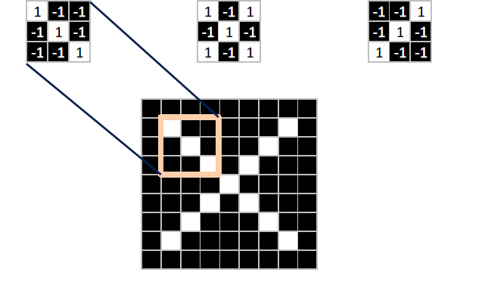
Convolutional Layer - Filters
Sliding the filter over the width and height of the input gives 2-dimensional activation map that responds to that filter at every spatial position.

Slide 41
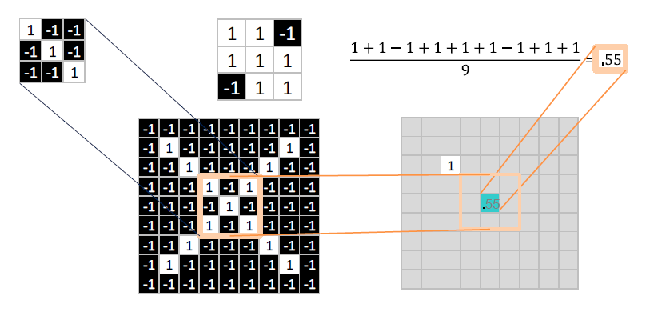
Convolutional Layer – Filters –Example

Slide 42
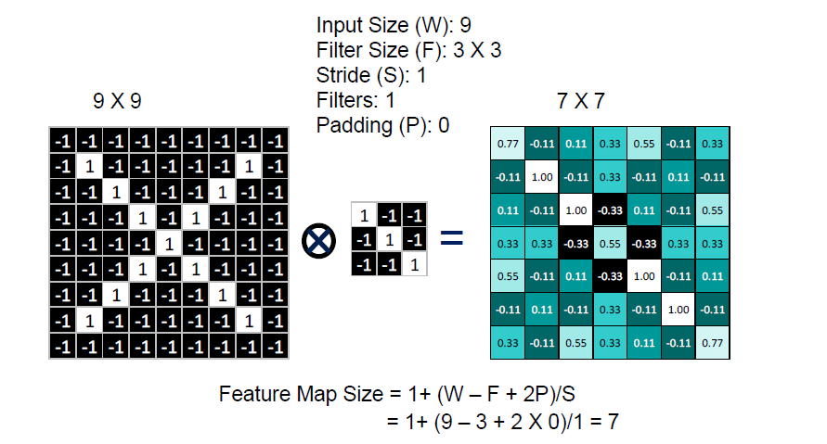
Convolutional Layer – Filters – Computation Example

Slide 43
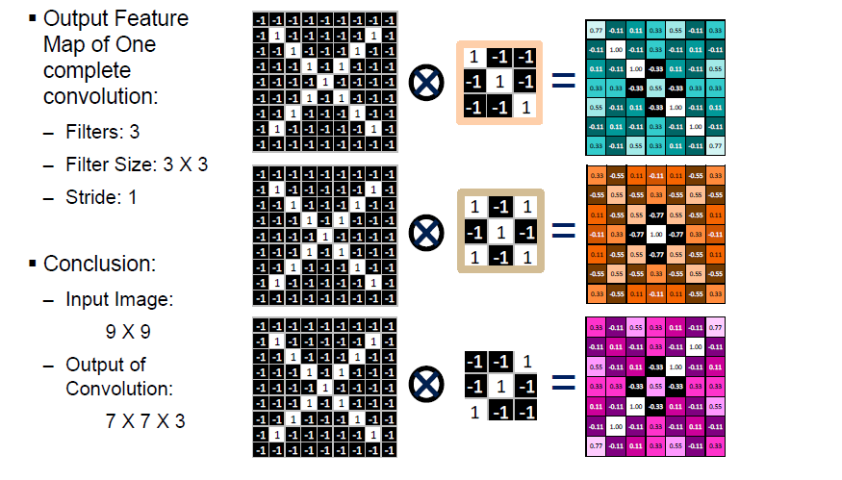
Convolutional Layer – Filters – Output Feature Map

Slide 44
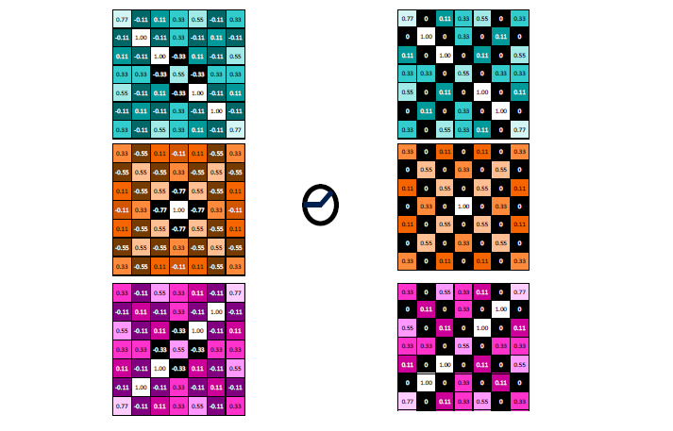
Relu Layer

Slide 45
Pool Layer
The pooling layers down-sample the previous layers feature map.
Its function is to progressively reduce the spatial size of the representation to reduce the amount of parameters and computation in the network
The pooling layer often uses the Max operation to perform the down sampling process.

Slide 46
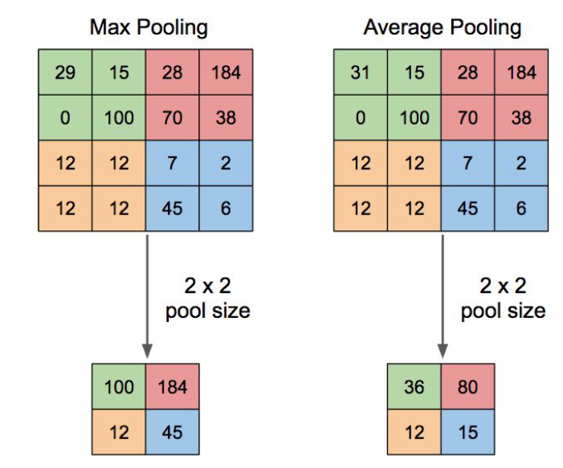
Pooling Filter example Size = 2 X 2, Stride = 2

Slide 47
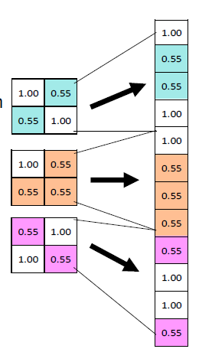
Fully connected layer
Fully connected layers are the normal flat feed-forward neural network layers.
These layers may have a non-linear activation function or a softmax activation in order to predict classes.
To compute our output, we simply rearrange the output matrices as a 1-D array.

Slide 48
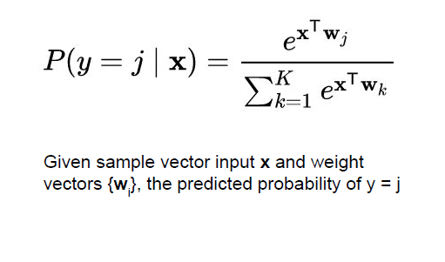
SoftMax operation
A special kind of activation layer, usually at the end of FC layer Outputs
Can be viewed as a fancy normalizer (a.k.a. Normalized exponential function)
Produce a discrete probability distribution vector
Very convenient when combined with cross-entropy loss

Slide 49
THANKS

Slide 50
QUESTIONS?

